Slide 1
INTERNET COMPUTING GitHub Static Hosting
FCAI 2024

Slide 2
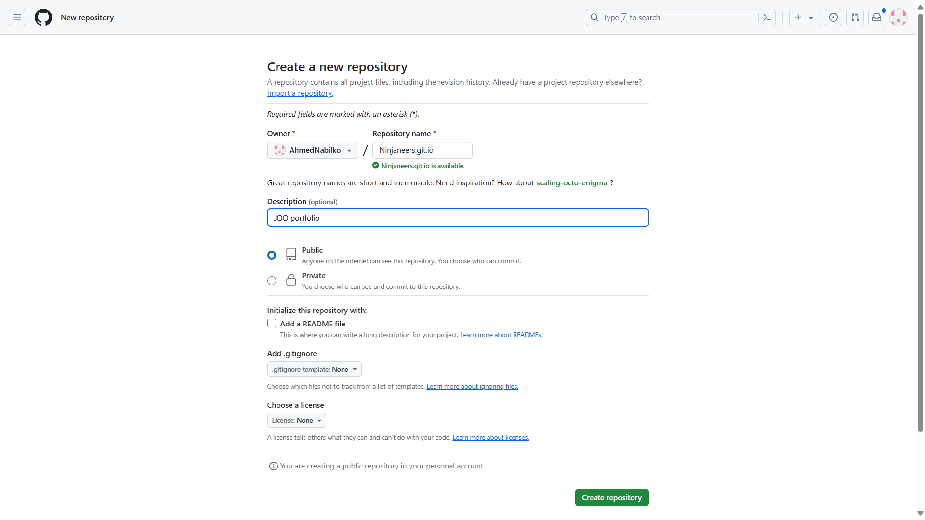
Step1: Create a new Repo

Slide 3
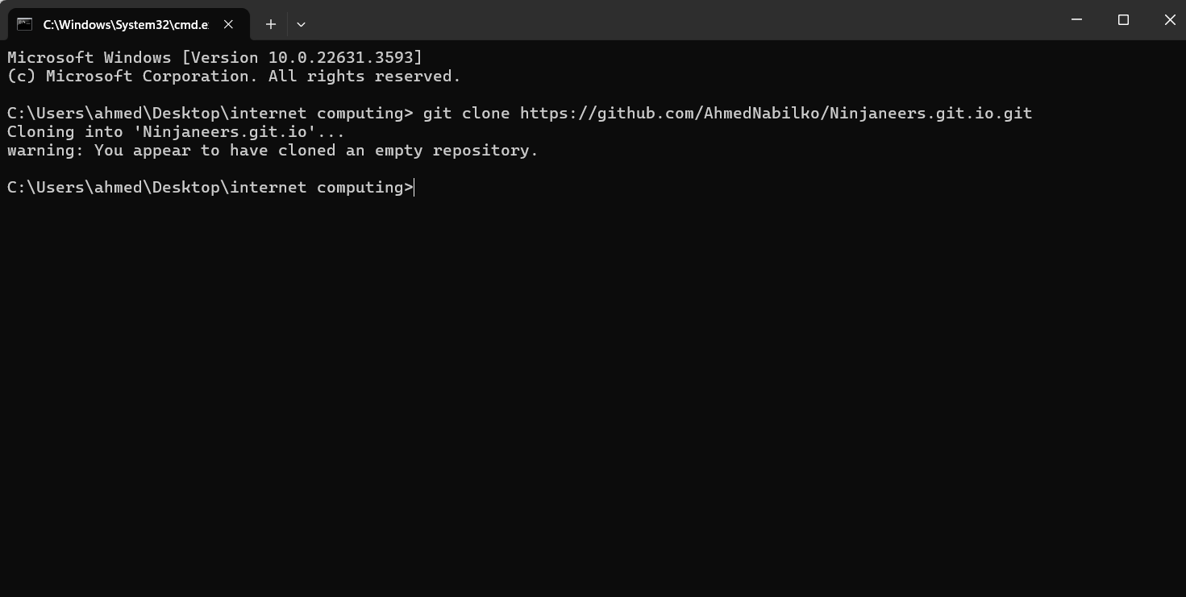
Step2: Clone The Repo

Slide 4
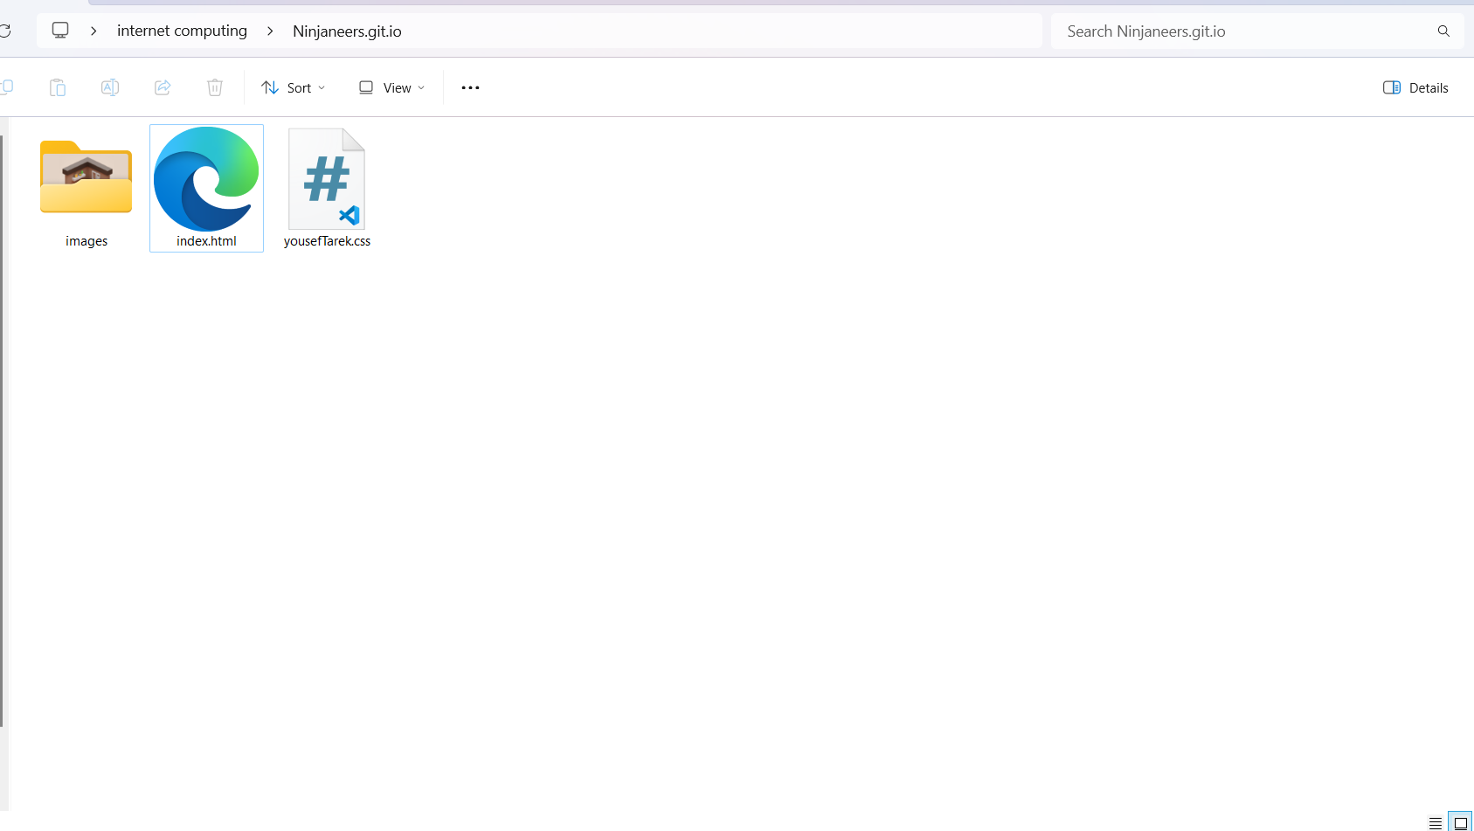
Step3: Add website files

Slide 5
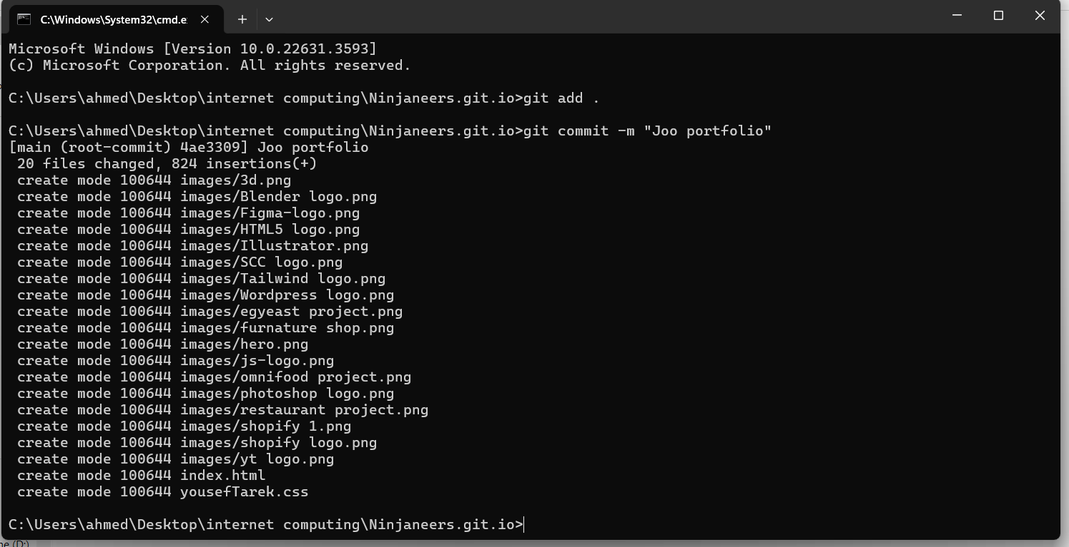
Step4: Create New Commit

Slide 6
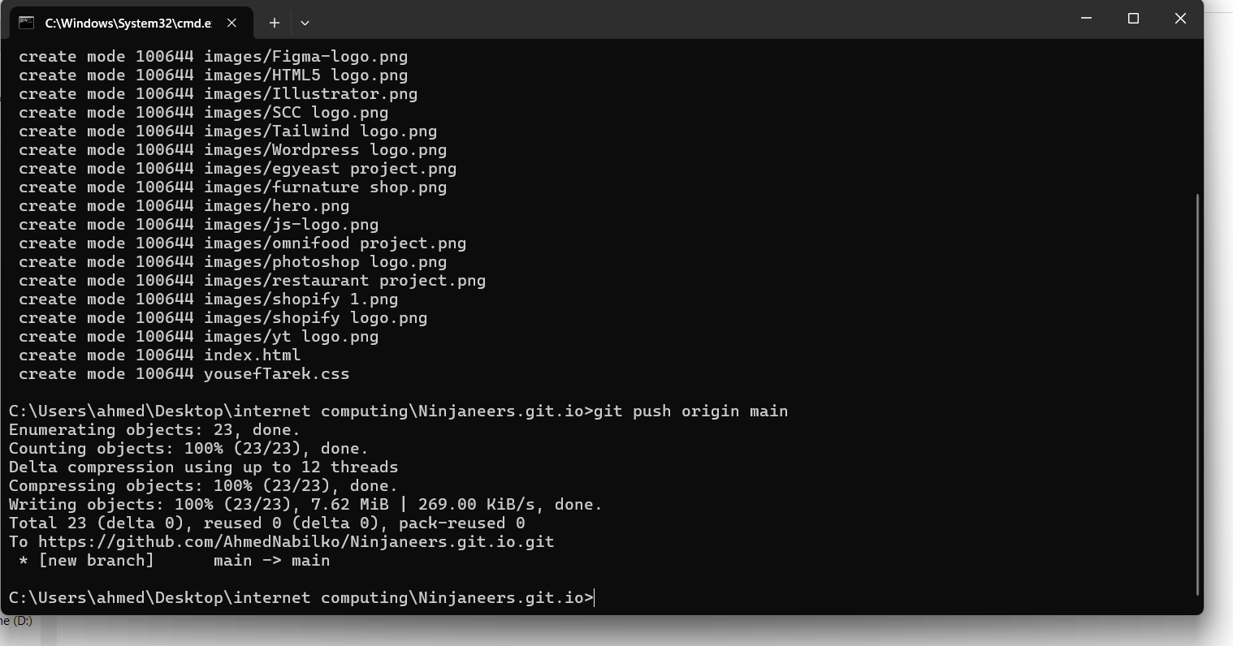
Step5: Push new files

Slide 7
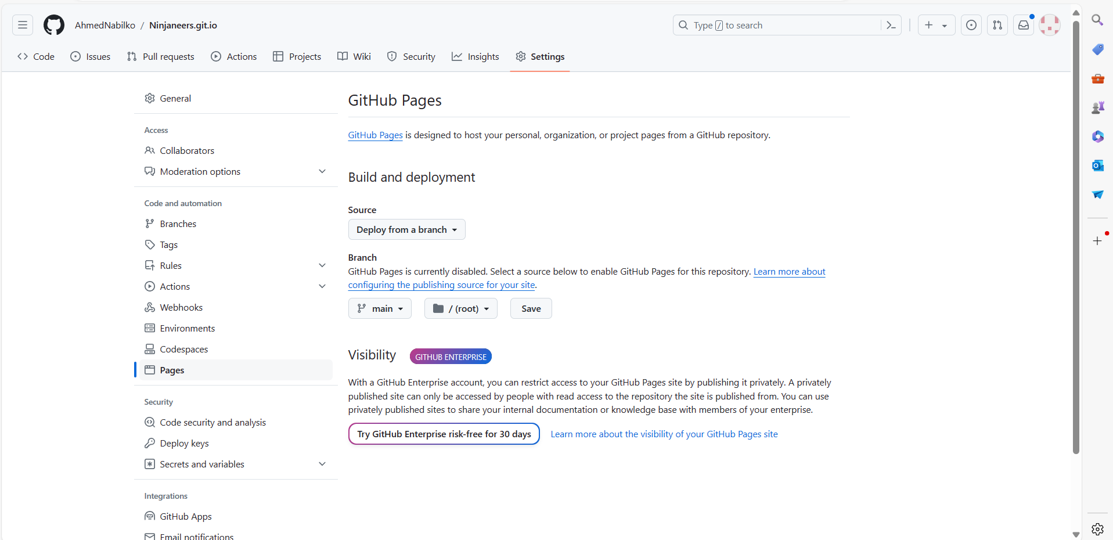
Step6: select main branch to deploy and click save

Slide 8
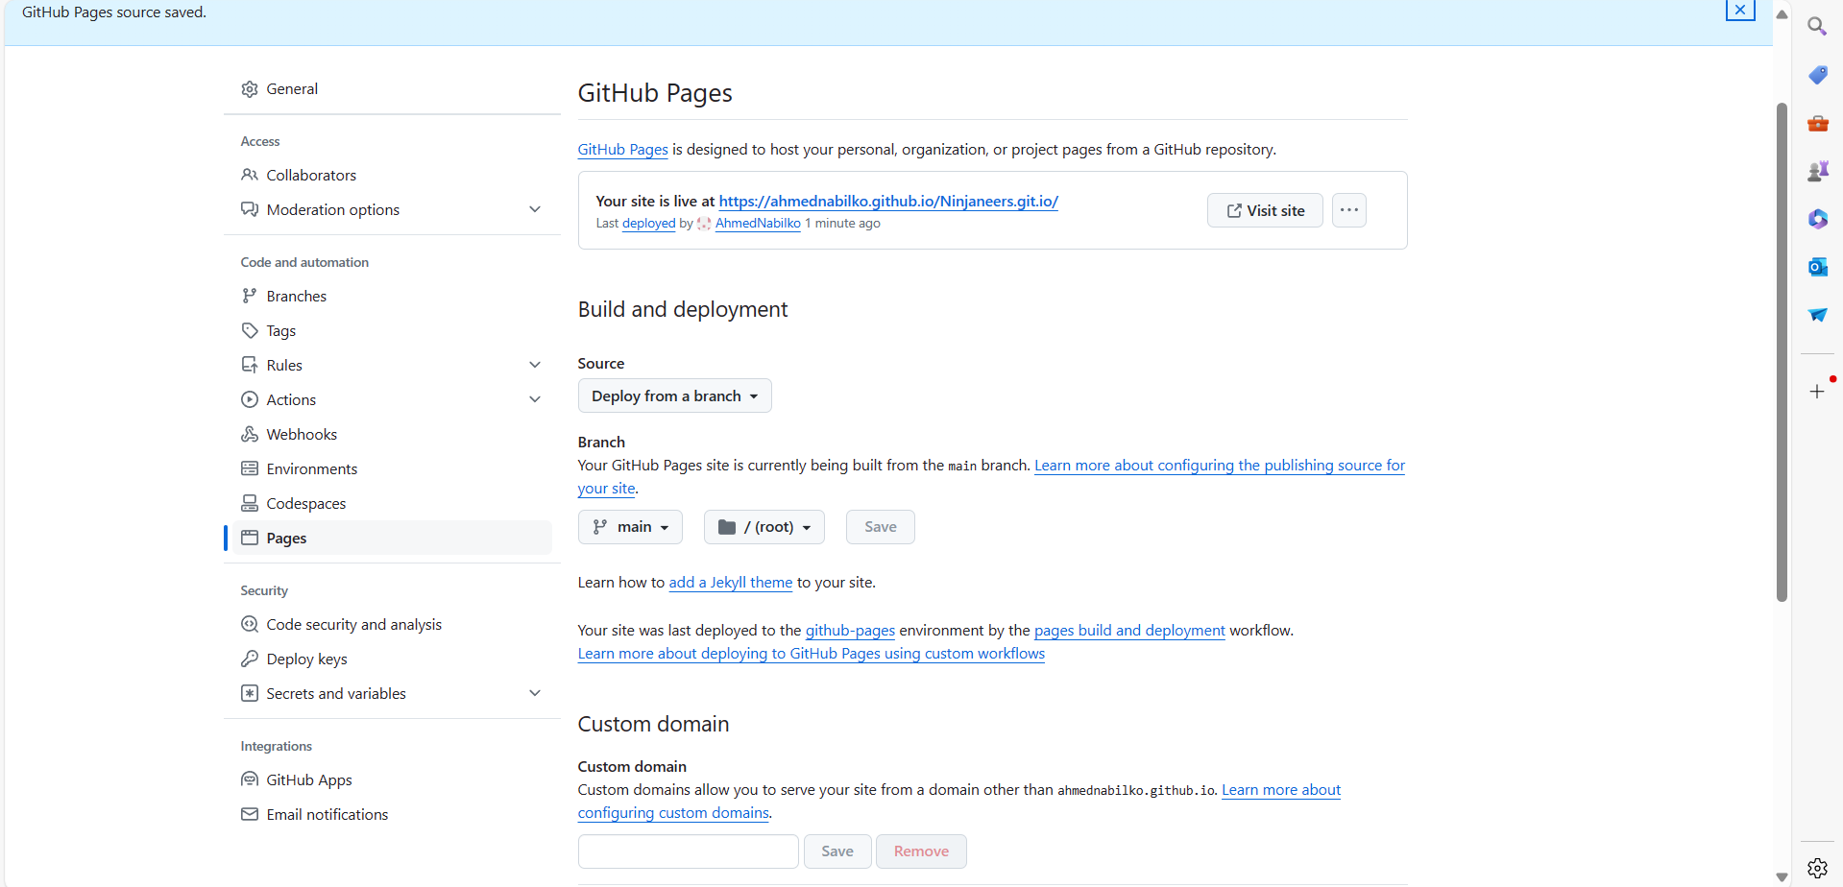
Step7: After saving click the link

Slide 9
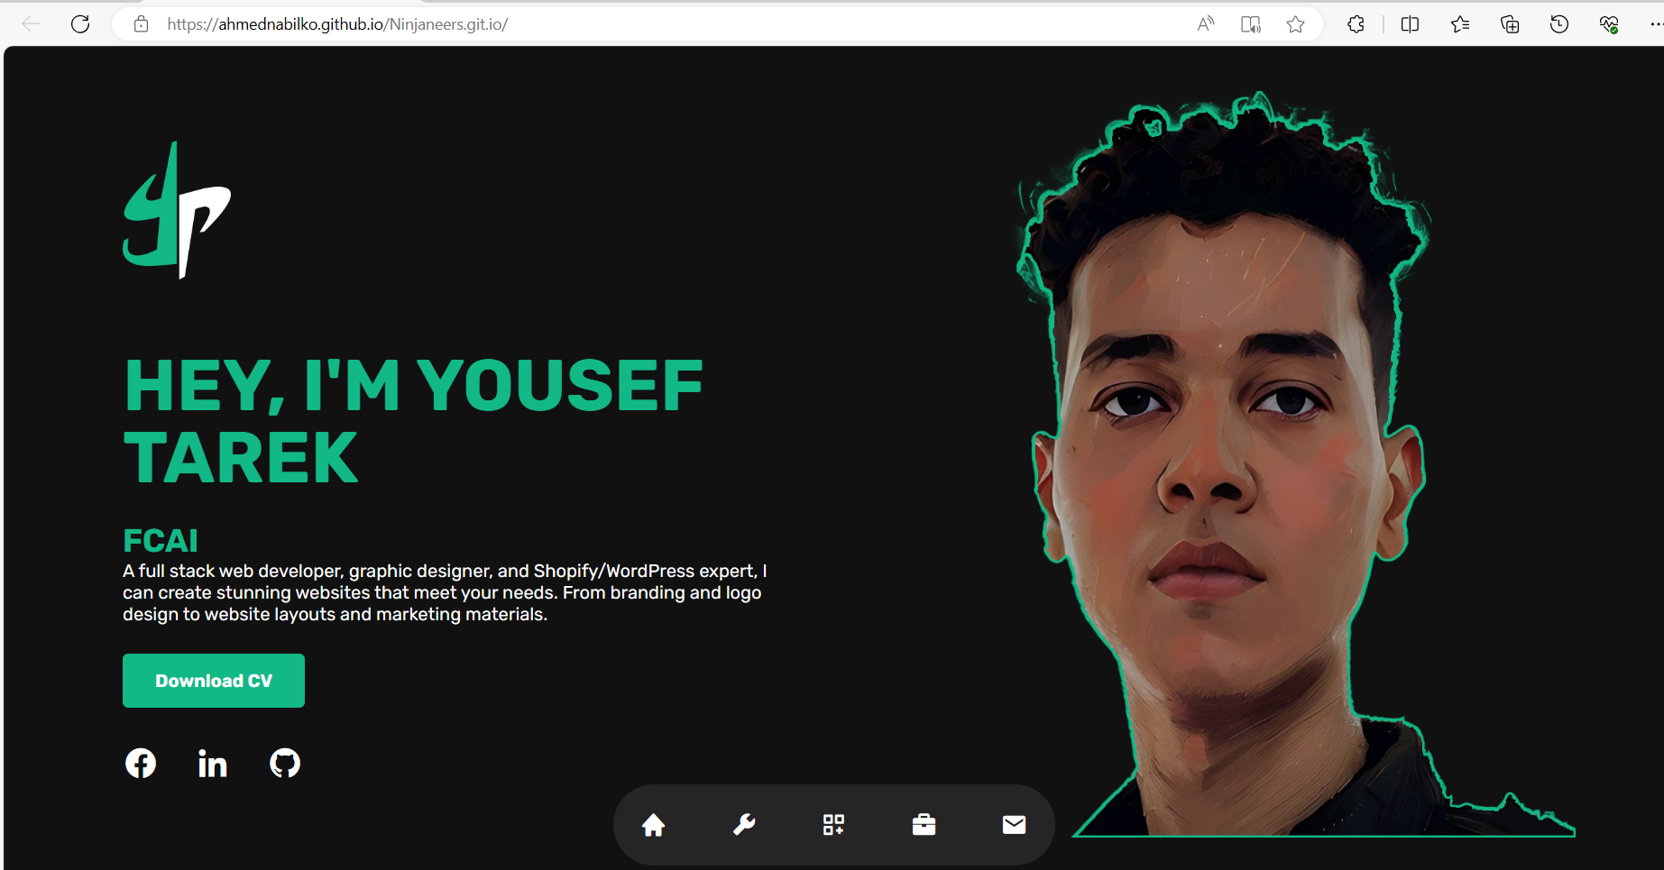
Step8: Here is the live demo

